Slide 1









Flattening the Curve:
Lockdown Strategies for Networked Epidemics
PRESENTED BY SACHI BARNABY
SUMMER INTENSIVE RESEARCH INTERNSHIP
MAY 31 - JULY 28, 2023

Slide 2

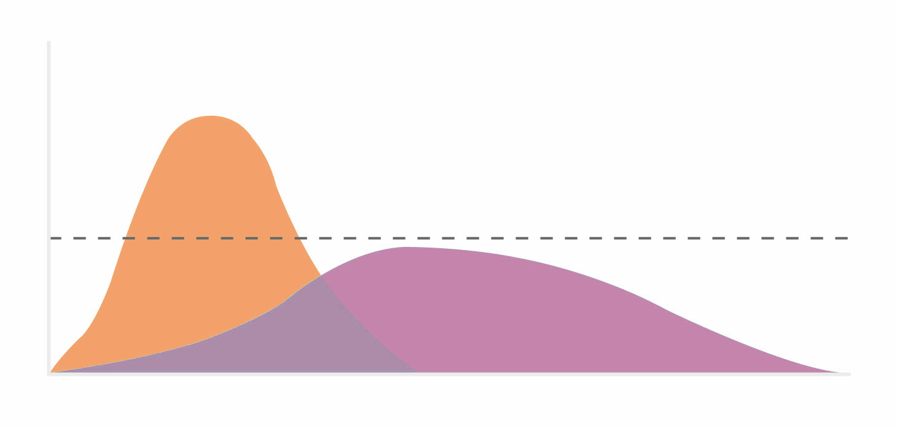
"Flattening the Curve"
Without Protective Measures
Number of Cases
Health Care System Capacity
With Protective Measures
Time since first case
Source: CDC, Drew Harris
Credit: Connie Hanzhang Jin/NPR
(1/12)

Slide 3

Broader Impact
(2/12)

Slide 4

Broader Impact
(3/12)

Slide 5


Problem Formulation
CONTROL STRATEGY:
LOCKDOWNS
where tₛ is the start time of lockdown
(4/12)

Slide 6
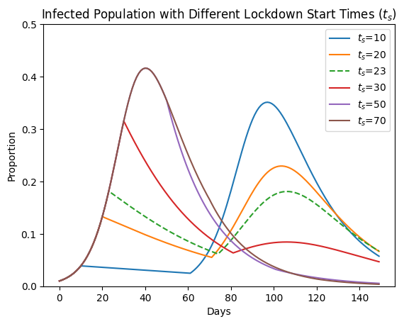
Problem Formulation
CONTROL STRATEGY:
LOCKDOWNS
where tₛ is the start time of lockdown
(5/12)
J.M. Greene and E.D. Sontag (2021).
Minimizing the infected peak utilizing a single lockdown:
A technical result regarding equal peaks

Slide 7
EPIDEMIC MODELS
S
I
R
SIR (Susceptible, Infectious, Recovered/Removed)
(6/12)

Slide 8
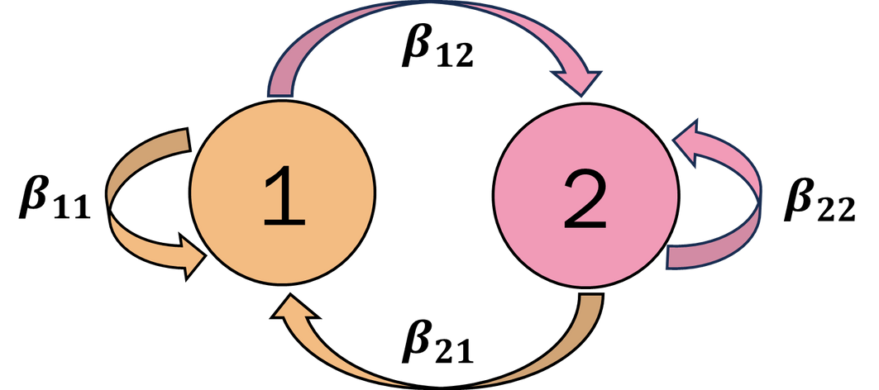
EPIDEMIC MODELS
S
I
R
SIR (Susceptible, Infectious, Recovered/Removed)
NETWORK CASE:
(7/12)

Slide 9
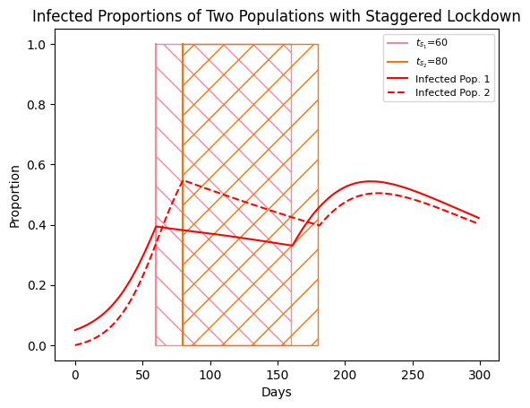
STAGGERED LOCKDOWN STRATEGY
(8/12)

Slide 10
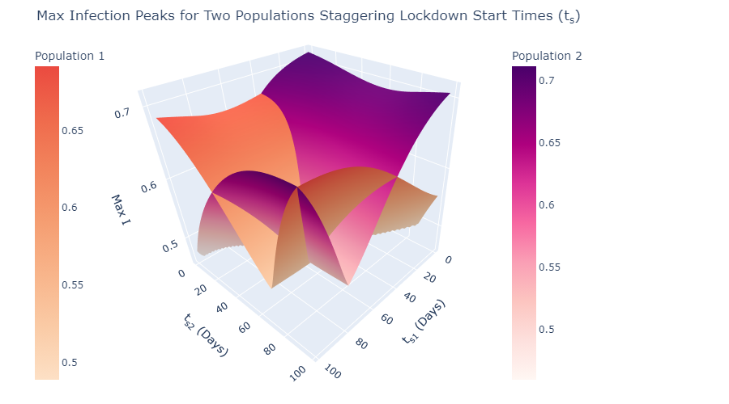
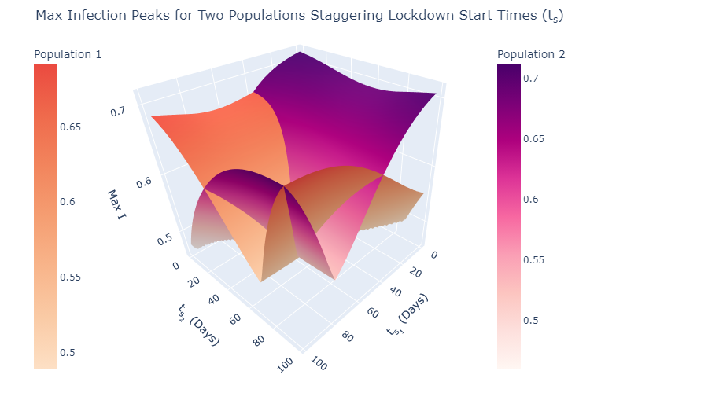
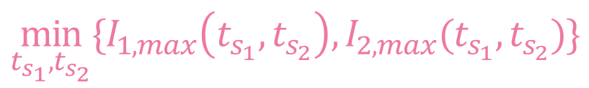
NETWORKED PROBLEM FORMULATION:
(9/12)

Slide 11
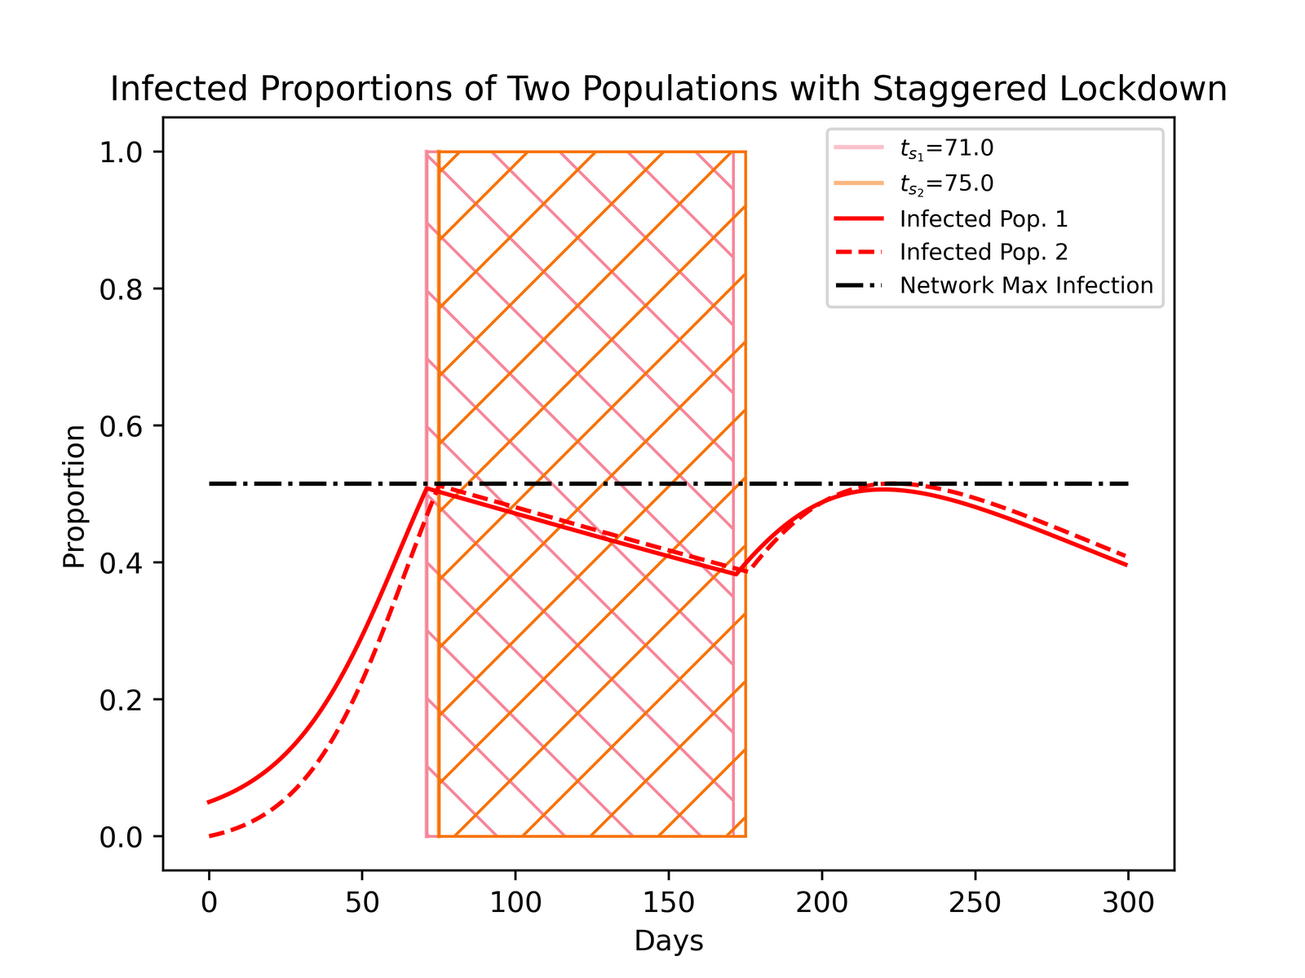
Collective Benefit Strategy
(10/12)

Slide 12
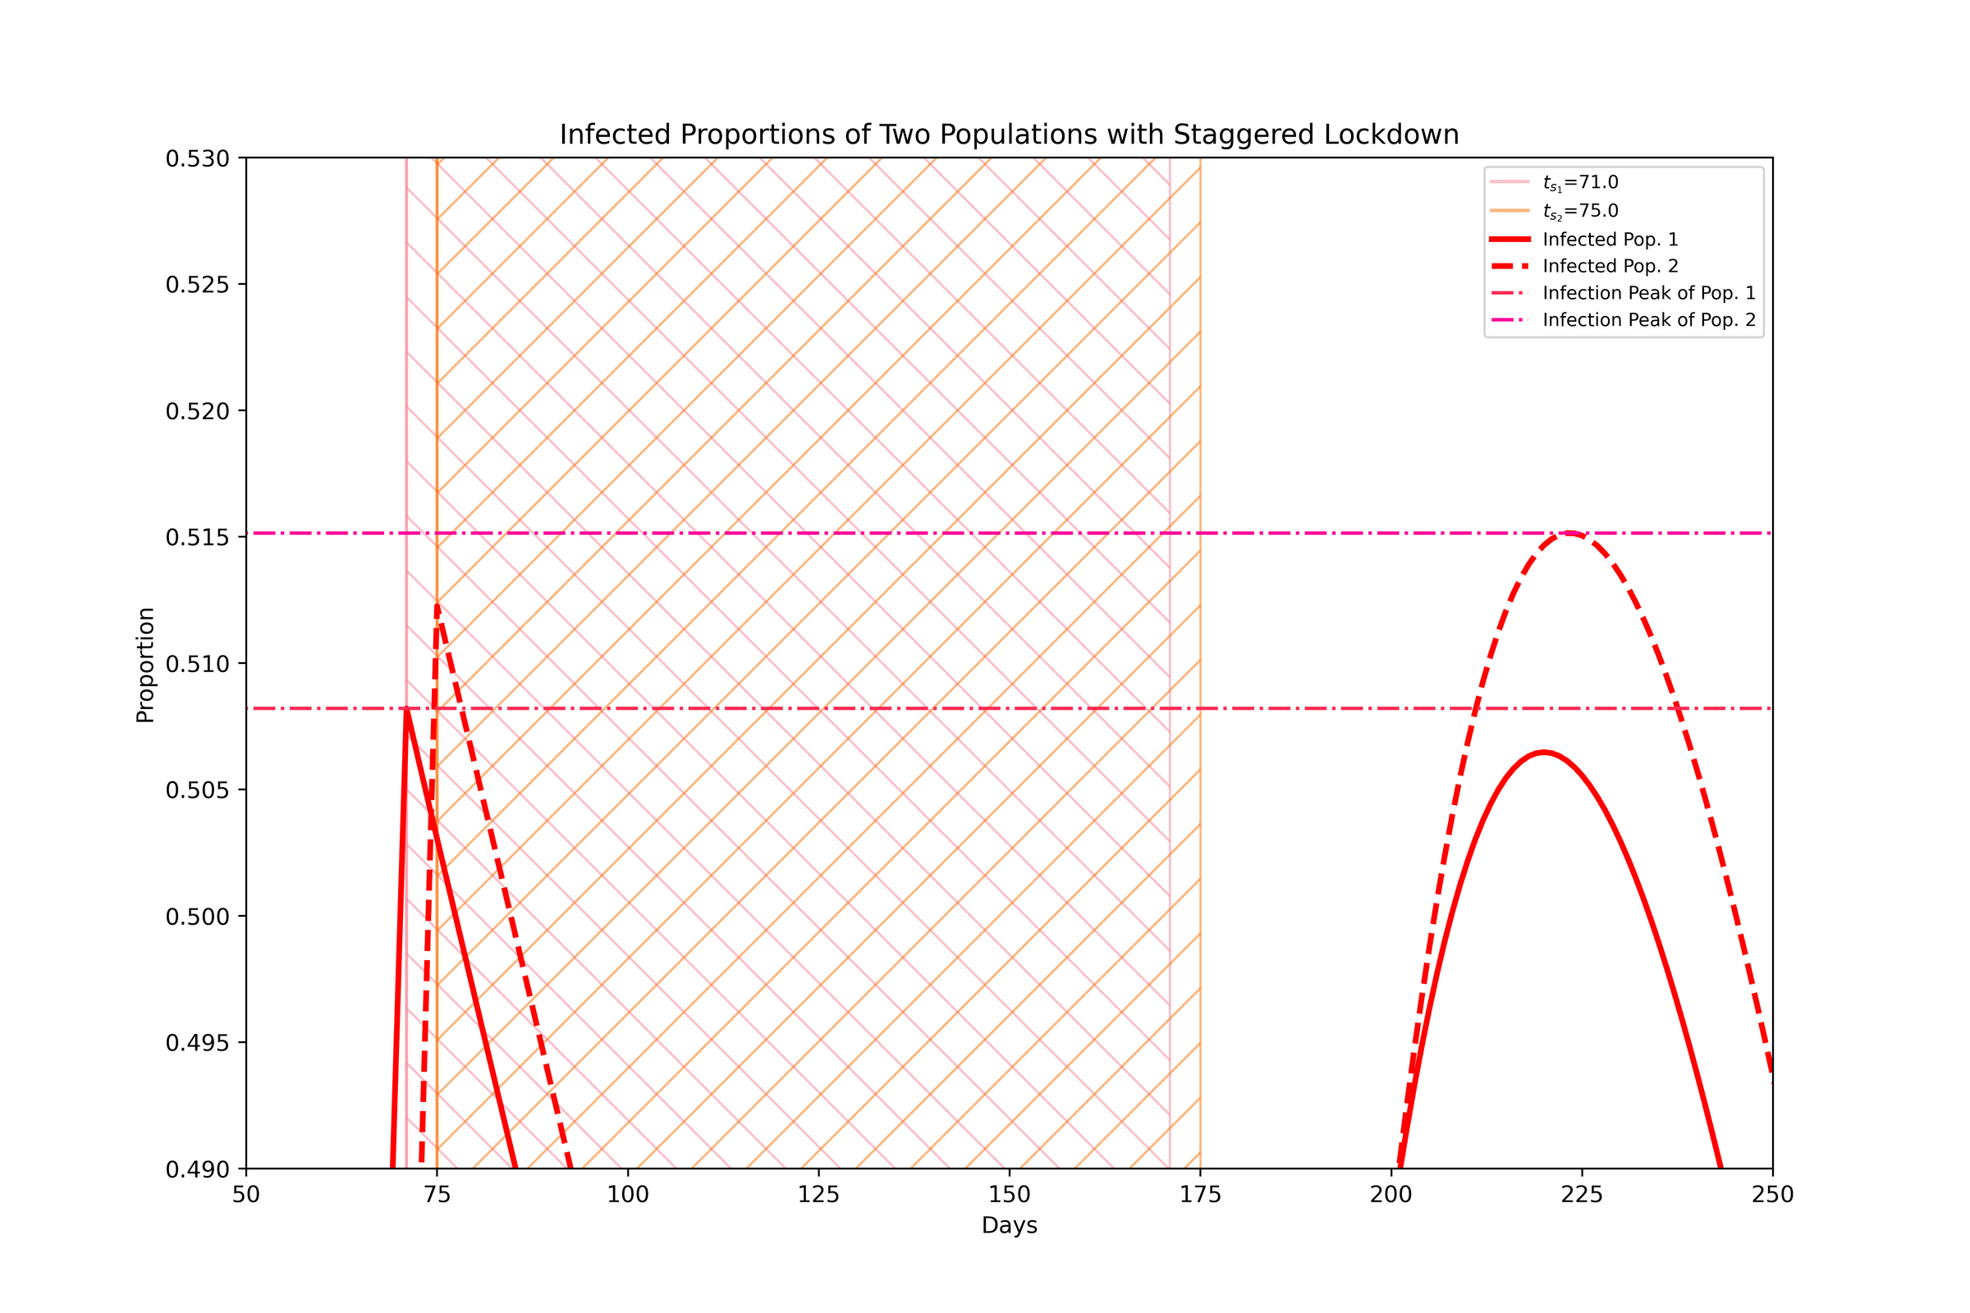
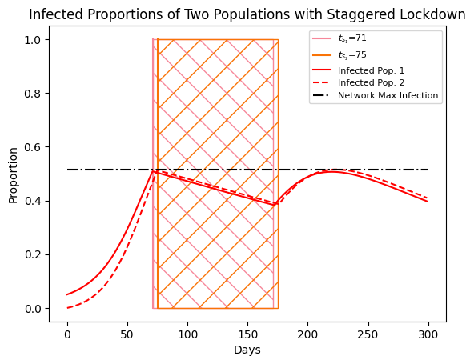
Collective Benefit Strategy
(11/12)

Slide 13
Future Work
Analysis
Other Epidemic Models
Other Lockdown Strategies
(12/12)

Slide 14


Acknowledgements
Brooks Butler (graduate mentor)
Professor Philip E. Paré (faculty advisor)

Slide 15
Thank you!
QUESTIONS?

